Slide 1
Business Intelligence Concepts, Tools, and Applications
Week 3: Data Visualization and Dashboard Design
Lesson 4: Dashboard Design Guidelines and Pitfalls

Slide 2
Dashboard Design Guidelines and Pitfalls
Learning objectives
Understand dashboard design guidelines
Understand common pitfalls of dashboard design

Slide 3
Dashboard Design Guidelines
Identify the audiences, and their interests and business purposes for the dashboards
Define critical metrics and their components
Create prototypes, sketches, mockups
Provide a dynamic and up-to-date view of the data
Develop a user friendly and customizable dashboard interface
Source Brath R. and Peters M. “Dashboard Design: Why Design is Important” . DM Review Online October 15 2004
Notes:
Source Brath R. and Peters M. “Dashboard Design: Why Design is Important” . DM Review Online October 15 2004- See references

Slide 4
Dashboard Design Guidelines: Structure
According to Few (2007), “Information cannot be placed just anywhere on the dashboard, nor can sections of the display be sized simply to fit the available space”.
Think about the information that you wish to prioritize.
Give information the space that it deserves.
Avoid devoting too much space to one data area.
Consider a simple structure such as a grid.
Adopted From: Stephen Few: Pervasive Hurdles to Effective Dashboard Design, Visual Business Intelligence Newsletter, January 2007
Notes:
According to Stephen Few (Pervasive Hurdles to Effective Dashboard Design, Visual Business Intelligence Newsletter, January 2007), there are the following action items to consider:
Think about the information that you wish to prioritize.
Give information the space that it deserves.
Avoid devoting too much space to one data area.
Consider a simple structure such as a grid.

Slide 5
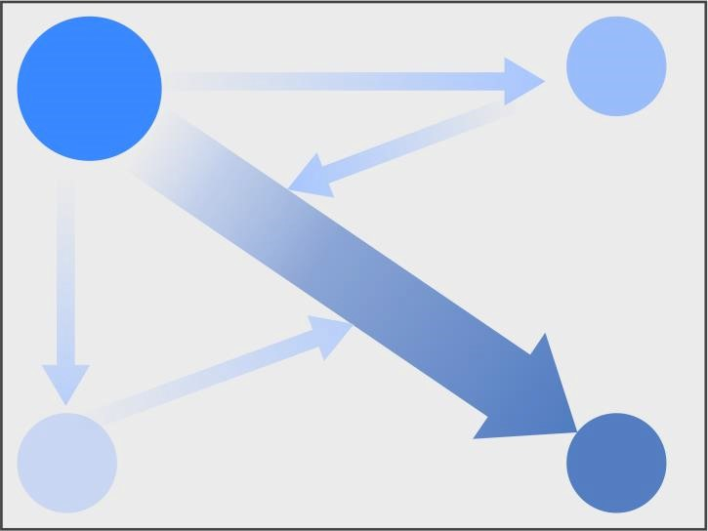
Dashboard Layout People have a bias in how they read and scan content
Place the Most Important Visualizations in the Top Left Corner
Primary Optical Area
Strong Fallow Area
Weak Fallow Area
Terminal Area
Adopted from Best Practices in Data Visualization, by Vihao Pham 2014
Notes:
From Best Practices in Data Visualization, by Vihao Pham 2014- See references

Slide 6
Dashboard Design Guidelines: Structure
According to Few (2007) one can link data sets together using various forms of structure:
A flow structure to represent a sequence of metrics.
A relationship structure to highlight how certain metrics are dependent on one another.
Grouping structure to group related information into categories or a hierarchy.
Source: Adapted from: Stephen Few: Pervasive Hurdles to Effective Dashboard Design, Visual Business Intelligence Newsletter, January 2007
Notes:
According to Stephen Few (Pervasive Hurdles to Effective Dashboard Design, Visual Business Intelligence Newsletter, January 2007) there are three forms of structures:

Slide 7
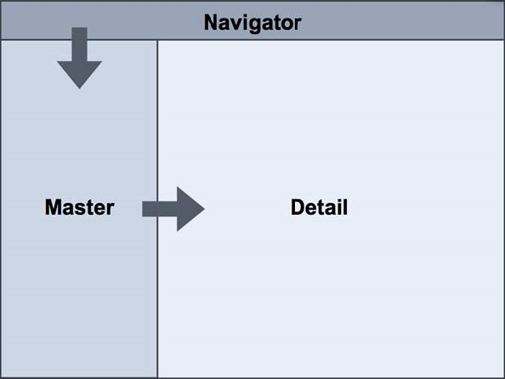
Dashboard Layout Place High-Level Visualizations to the Left, Detail Visualizations to the Right and Bottom
Present Data Hierarchically
Source: Adapted from Best Practices in Data Visualization, by Vihao Pham 2014
Notes:
Adopted from Best Practices in Data Visualization, by Vihao Pham 2014-- See references

Slide 8
Dashboard Quantity and Ranking of data included
Customization | One-size-fits-all: Presented as a single view for all users Customizable: Functionality to let users create a view that reflects their needs
Level of Detail | High: Presenting only the most critical top-level numbers Drill-able: Providing the ability to drill down to detailed numbers to gain more context
Point of view | Prescriptive: The dashboard explicitly tells the user what the data means and what to do about it Exploratory: User has latitude to interpret the results as they see fit
Source: Adopted from: A Guide to Creating Dashboards People love to use, translating Delicious Data into a Beautiful Design Version 2.0. May 2015
Notes:
Adopted from: A Guide to Creating Dashboards People love to use, translating Delicious Data into a Beautiful Design Version 2.0. May 2015 - See references

Slide 9
Design Principles
Use modularity to compact information
Present information in increasing levels of detail
Use visual cues to guide attention
Support casual use and minimize barrier to entry for new users
Guide users and lead their actions based on their results
Use filters to allow flexibility and customization
Provide explanation and context before information
Adopted from A Guide to Creating Dashboards People love to use, Juice, 2009-2010.
Notes:
According to the A Guide to Creating Dashboards People love to use, Juice, 2009-2010, there are several design principles for dashboards:

Slide 10
Dashboard Design Pitfalls
According to Few (2013, 2007) dashboard designers need to avoid the following:
Exceeding the boundaries of a single page
Exceeding the Boundaries of a single Screen
Supplying inadequate context for the data
Displaying Excessive Detail or Precision
Expressing Measures indirectly
Choosing inappropriate display media
Introducing Meaningless Variety
Using Poorly Designed Display Media
Encoding Quantitative Data Inaccurately
Arranging the Data Poorly
Ineffectively highlighting what’s important
Cluttering screen with useless decoration
Misusing or overusing color
Designing an unappealing Visual Display
Adopted from: (1) Few S., Dashboard Design for at-a-glance monitoring. /, (2) Few, S. Pervasive Hurdles to Effective Dashboard Design, Visual Business Intelligence Newsletter, January 2007.
Notes:
Adopted from: (1) Few S., Dashboard Design for at-a-glance monitoring. http://www.perceptualedge.com/, (2) Few, S. Pervasive Hurdles to Effective Dashboard Design, Visual Business Intelligence Newsletter, January 2007. See the sources for more detail.

Slide 11
Dashboard Design Guidelines Functionality
Various dashboard design guidelines (Matillion 2015, Juice 2009) points to the importance of the following functionalities
Drill down
Filters
Comparison
Alerts
Edit/Save
Creating Reports
Sources: Adopted from “How to Create Compelling Business Dashboards - Complete Guide, (2) A Guide to Creating Dashboards People love to use, Juice, 2009-2010.
Notes:
Sources: Adopted from: How to Create Compelling Business Dashboards - Complete Guide, and A Guide to Creating Dashboards People love to use, Juice, 2009-2010.

Slide 12
Dashboard Design Guidelines Advanced Functionality
According To Juice (2009), the advanced functionalities include the following
Text-based summary
Starring/tagging
Annotation
Advanced visualizations
Source: Adopted from A Guide to Creating Dashboards People love to use, Juice, 2009-2010.
Notes:
According to A Guide to Creating Dashboards People love to use, Juice, 2009-2010.. The advanced functionalities includes the following:

Slide 13
Dashboard Design Action Items
According to Radha (2008), there are eight actions that are important to consider:
Benchmarking KPIs with industry standards
Wrapping the metrics with contextual metadata
Validating the design by a usability specialist
Prioritizing and ranking alerts and exceptions
Enriching dashboard with business-user comments
Presenting information in three different levels
Picking the right visual constructs
Providing for guided analytics
From the book: Eight Best Practices in Dashboard Design Radha R April 10, 2008.
Notes:
According to Eight Best Practices in Dashboard Design Radha R April 10, 2008. One needs to consider the following eight action items :

Slide 14
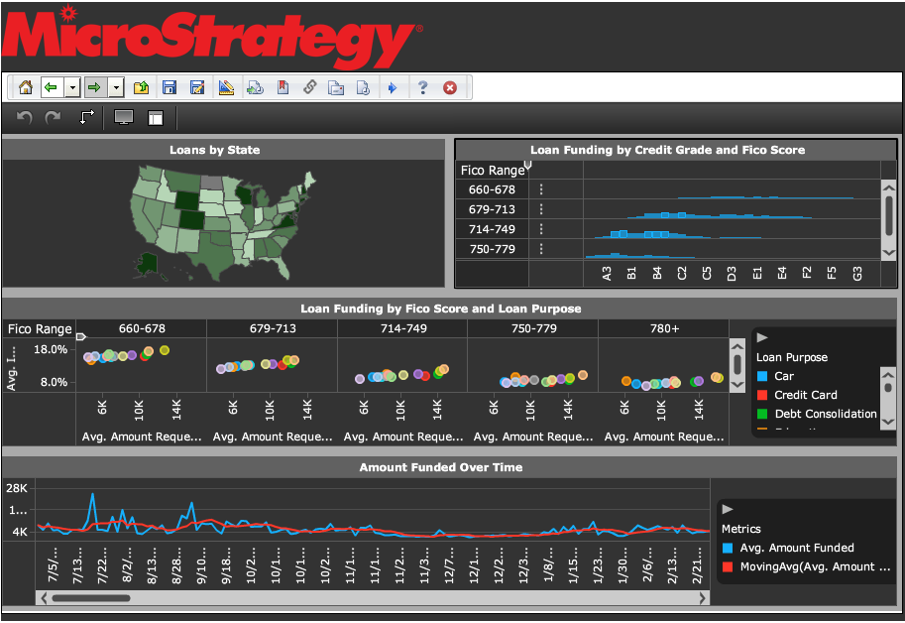
Exercise 4: Embedded Self-Service

